Slide 1
FUNDAMENTAL ANALYSIS OF STOCKS
-DEBASHREE PRIYA SAHOO(200307)
- TANISHA AGRAWAL(190892)

Slide 2
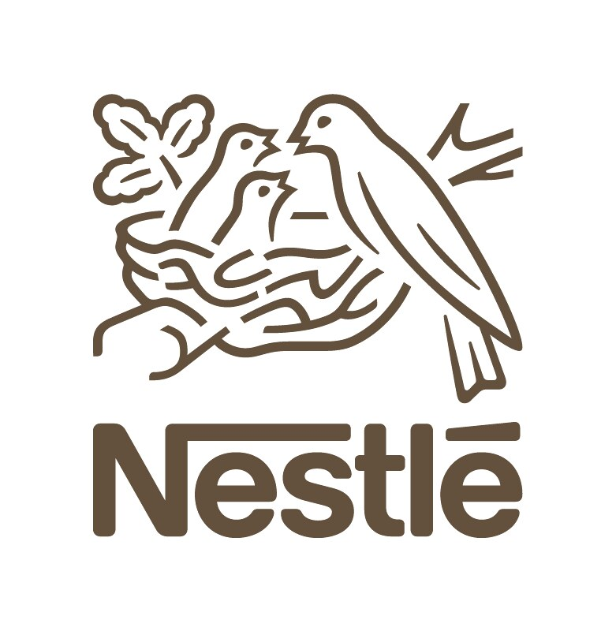
COMPANY:NESTLE INDIA

Slide 3
TABLE OF CONTENTS
01
02
03
About the Company
Past to the Present
Products of Nestle

Slide 4
TABLE OF CONTENTS
04
05
06
FINANCIAL RATIOS
FINANCIAL RATIO(EXPLAINED)
MANAGEMENT

Slide 5
TABLE OF CONTENTS
07
08
09
BUSINESS MODEL & GROWTH
FUTURE PROSPECTS
CONTROVERSIES

Slide 6
ABOUT THE COMPANY
Nestle India is a subsidiary of Nestle SA of Switzerland.
Nestle India Ltd is one of the biggest and well-known player of FMCG(Fast Moving Consumer Goods) sector.
As of till 2020, the parent company Nestle owns 62.76% of Nestle India.
Nestle India involved in manufacturing of many food products and gained trust of Indians for a century now by its standards and sustainable growth.

Slide 7
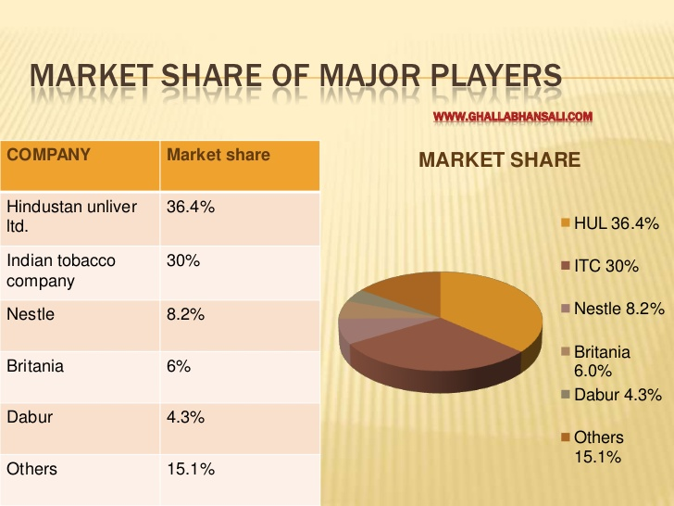

Slide 8
PAST TO THE PRESENT
1912
1961
1967
1989
Nestle traded as Nestle Anglo-Swiss Condensed Milk Company Ltd
Set up First factory in Moga, Punjab
Manufacturing facility in Choladi, Tamil Nadu
Nanjangud, Karnataka

Slide 9
PAST TO THE PRESENT
1992
1995 & 1997
2006
2012
Manufacturing facility at Samalkha, Haryana
Manufacturing facility at Ponda and Bicholim, Goa
Manufacturing facility at Pantnagar, Uttarakhand
Manufacturing facility at Tahliwal, Himachal Pradesh

Slide 10
PRODUCTS OF NESTLE
BEVERAGES
BREAKFAST CEREALS
CHOCOLATES & CONFECTIONERY
Nescafe
Nescafe Classic
Nescafe Gold
Nescafe Sunrise
Nestea
Nescafe Latte
Koko Crunch
NesPlus Crunchy Flakes
NesPlus Crunchy Granola
Nestle Bar One
Nestle Kitkat
Nestle Munch
Nestle Milkybar

Slide 11
PRODUCTS OF NESTLE
FOODS
NUTRITION BRANDS
DIARY PRODUCTS
Maggi
Maggi Fusian
Maggi Cuppa
Maggi Pasta
Maggi Sauce
Maggi Coconut Powder
Nestle Lactogrow
Nestle Ceregrow Range
Nestle Nangrow
Nestle Cold Coffee
Nestle Milkmaid
Nestle Yoghurt
Nourish Milk

Slide 12
FINANCIAL RATIOS
EPS(in ratio): Earning Per Share
Companies | 2020 | 2019 | 2018 | 2017
Nestle India | 215.98 | 204.28 | 166.67 | 127.07
Britannia Inds | 61.75 | 46.71 | 78.96 | 70.31
Hindustan Unilever | 31.13 | 27.89 | 24.20 | 20.75
ITC | 12.33 | 10.19 | 9.22 | 8.43
JubilantFoodworks | 20.87 | 24.46 | 31.29 | 10.21

Slide 13
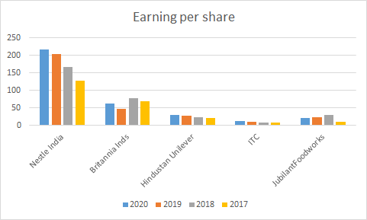

Slide 14
FINANCIAL RATIOS
2. Net Profit Margin(in %):
Companies | 2020 | 2019 | 2018 | 2017
Nestle India | 15.59 | 15.91 | 14.23 | 12.24
Britannia Inds | 13.50 | 10.70 | 10.18 | 10.02
Hindustan Unilever | 17.37 | 15.79 | 15.16 | 14.07
ITC | 33.17 | 27.70 | 27.62 | 25.44
JubilantFoodworks | 7.08 | 9.14 | 6.92 | 2.64

Slide 15
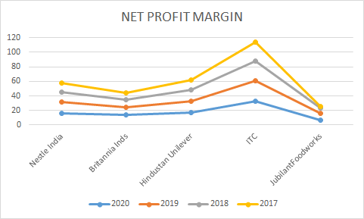

Slide 16
FINANCIAL RATIOS
3. EV/EBITDA(ratio): Enterprise Value-to-earnings before interests, taxes, depreciation and amortization.
Companies | 2020 | 2019 | 2018 | 2017
Nestle India | 52.46 | 44.55 | 36.68 | 32.65
Britannia Inds | 31.27 | 39.95 | 38.05 | 30.05
Hindustan Unilever | 47.55 | 39.26 | 36.35 | 29.64
ITC | 9.78 | 18.19 | 17.53 | 20.40
JubilantFoodworks | 48.38 | 28.34 | 32.45 | 27.82

Slide 17
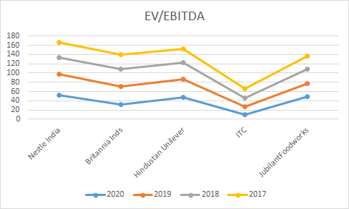

Slide 18
FINANCIAL RATIOS
4. ROE(in %): Return on Equity
Companies | 2020 | 2019 | 2018 | 2017
Nestle India | 103.12 | 102.58 | 43.74 | 35.81
Britannia Inds | 35.94 | 27.78 | 33.00 | 37.00
Hindustan Unilever | 83.89 | 78.80 | 74.02 | 69.18
ITC | 23.63 | 21.50 | 21.83 | 22.49
JubilantFoodworks | 22.07 | 22.07 | 19.77 | 2.08

Slide 19
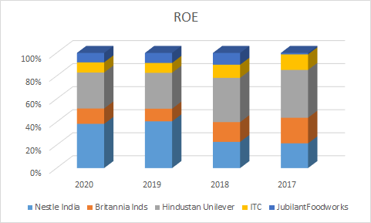

Slide 20
FINANCIAL RATIOS
5. Debt to Equity(in ratio):
Companies | 2020 | 2019 | 2018 | 2017
Nestle India | 0.02 | 0.03 | 0.01 | 0.01
Britannia Inds | 0.28 | 0.00 | 0.00 | 0.00
Hindustan Unilever | 0.00 | 0.00 | 0.00 | 0.00
ITC | 0.00 | 0.00 | 0.00 | 0.00
JubilantFoodworks | 0.00 | 0.00 | 0.00 | 0.00

Slide 21
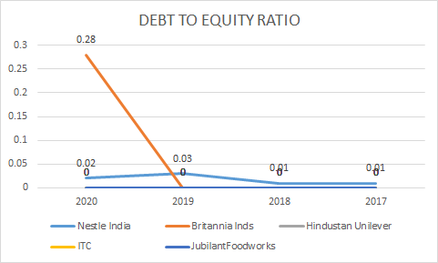

Slide 22
FINANCIAL RATIOS(Explained)
EPS-Earning per share-It is a company’s net profit divided by the number of common shares it has outstanding. EPS indicates how much money a company makes for each share of its stock and is widely uses to estimate corporate value.
EPS = Net income - preferred dividends / End of period Common Shares outstanding
A higher EPS indicates greater value as investors will pay more for a company’s shares if they think the company has higher profits relative to its share price.The higher the ratio the more profitable and valuable it is
NET PROFIT MARGIN%- It measures how much net income or net profit is generated as a percentage of revenue.It helps investors to assess if a company’s management is generating enough profit from its sales and whether operating costs and overhead costs are being contained.
NET PROFIT MARGIN%=net profit/net sales

Slide 23
Net income=Net profit and net sales= revenue
A higher percentage means efficient management
3. EV/EBITDA- The enterprise value to EBITDA or earnings before interest, taxes,depreciation and amortization.Typically ratios below 10 are seen as healthy.The lower the ratio the cheaper the valuation for a company.It is a financial metric that measures the return a company makes on its capital investments.The higher the ratio the more overvalued the company is.
Enterprise value-It is a measure of company’s total value,it includes company’s market capitalization value and short term and long term debt as well as any cash on the company’s balance sheet . EV=MC+D-C
EBITDA shows the true picture of a company’s assets.Generally on a level of 10 scale 4 is the perfect EV/EBITDA ratio and also perfect value to buy a share
4. ROE%- It is a measure of financial performance calculated by dividing net income by shareholder’s equity.It measures a corporation’s profitability in relation to stockholder’s equity
ROE= Net income/Average Shareholder’s equity

Slide 24
A higher ROE is better while a falling ROE may indicate a less efficient usage of equity capital .But a very high ROE can be the result of high financial leverage which is dangerous for a company’s solvency
If a company takes more debt then ROE increases so more ROE doesn’t mean it's good, it can lead to future problems
High debt+High ROE=financially weak
No/less debt+less ROE=financially strong
At least 15% is considered good ROE
5. DEBT to EQUITY ratio-It is used to evaluate a company’s financial leverage.It is a measure of degree to which a company is financing its operations through debt versus wholly owned funds.It reflects the ability of a shareholder to cover all outstanding debts in the event of a business downturn.A high ratio means the company has been aggressive in financing its growth with debt.
Debt to equity ratio=Total liabilities/total shareholder’s equity

Slide 25
MANAGEMENT
B Murli: Senior VP(Legal) & Co. Secretary
David S McDaniel: Executive Director & CFO
Matthias C Lohner: Executive Director-Technical
PR Ramesh: Ind. Non-Executive Director
Rajya Vardhan Kanoria: Ind. Non-Executive Director
Rama Bijapurkar: Ind. Non-Executive Director
Roopa Kudva: Ind. Non-Executive Director
Suresh Narayanan: Chairman & Managing Director
Swati A Piramal: Ind. Non-Executive Director

Slide 26
BUSINESS MODEL & GROWTH
In the Business model of NESTLE INDIA had 61 new product and brand launches since 2016 and is focussed on deeper penetration in the Indian market with a wider portfolio.
This company has reduced debt and almost debt free.It has delivered good profit growth of 18.65% CAGR over last 5 years. The company has a good return on equity track record:3 Years ROE 68.06%. Company has been maintaining a healthy dividend payout of 109.71%. The Operating income and Net income has also increased by 10.9% and 10.5% CAGR respectively. There was a revenue drop in 2016 due to the MAGGI controversy. The working Capital has been positive and the Cap-Ex has remained stable over the years which indicates a linear growth model for the company.
But still there are some cons associated with the company.The stock is trading at 83.59 times its book value and has delivered a poor sales growth of 10.31% over past 5 years.

Slide 27
Suresh Narayanan, MD & Chairman, Nestle India, attributed that the recent change in their operating model was a major game-changer. They divided the country into 15 consumer clusters and the idea was to offer more focussed solutions to consumers. How has this made a difference? The company earlier had a single strategy for the entire country. There was a national Maggi, Nescafe or KitKat plan, and this was the cause of consumer disconnect"Earlier, it was geography that was defining the customer and then it was defining the brand and category and then finally it would touch upon the consumer. It was painting the country with one single plan. The effort now wass to look at the country from the lens of consumer first, rather than geography first,". The company now has a more individualised plan for Tamil Nadu, Andhra Pradesh or Uttar Pradesh. For a product like coffee, analytics has helped them to target consumers based on their consumption frequency, the equity for different kinds of coffee, consumption occasion and so on. Nestle, which largely used national media vehicles to reach out to its consumers, has now started including regional media in its media plan.

Slide 28
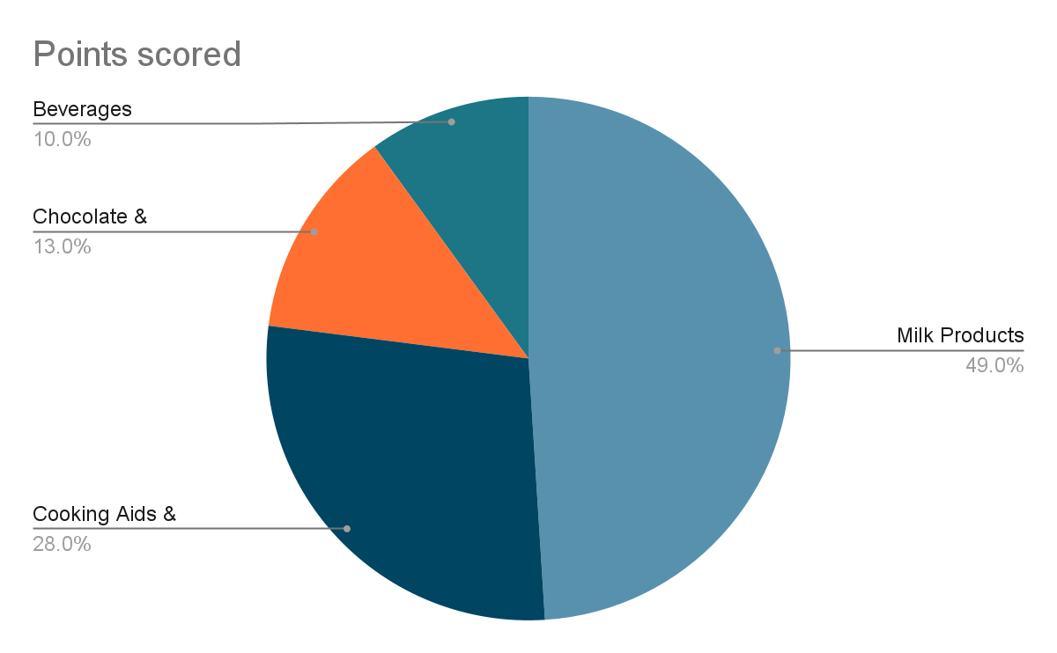
REVENUE DISTRIBUTION OF NESTLE INDIA:

Slide 29
FUTURE PROSPECTS
Some insights for the coming years from the analysis,management discussions,con calls are as follows:
The company will face a double digit revenue decline due to the covid 19 outbreak and the subsequent lockdown.However Nestle is better placed than other FMCG companies due to its large portfolio of milk products as they were a part of essential items.
The near term concern for the company is tackling the slowdown in consumption, restoring supply chains and managing labour crunch.The situation is only expected to improve after FY21 depending upon the effect on per capita income of the company.
KITKAT,MUNCH,NAN,MAGGI NOODLES AND masala-ae-magic are outperformers in the overall product portfolio.Some of the products have seen a double digit increase in revenue contribution.The company has also stepped up dividend per share over the years after the MAGGI issue which shows management’s dedication to the shareholder’s interest.

Slide 30
The company is looking forward to increase its rural presence through Re-distributors and wholesale hub models.
The company currently has 7000+ Re-distributors and 2600+ wholesale distributors.This may see a 5-10% increase in the near future after the improvement of covid 19 pandemic.
Overally, the company has a solid fundamental and a strong cash position and it has demonstrated capabilities in steering the company through this uncertain times.
So, nestle still remains a good long term investment at a suitable entry point.

Slide 31
ASSUMPTIONS TAKEN FOR FUTURE ANALYSIS
1. SALES: Assumed that sales will increase each year on linear levels by 0.36% after covid situation is over.As growth rate for sales as assumed from the quarter report 2021 of Nestle india is 8.36% and for year 2020 growth rate is 8.09% so by assumption growth of sales will increase linearly by 0.36% for the future years (2021-2025).
2. GROSS PROFIT MARGIN%: Assumed gross profit margin will increase on similar levels in future so average is taken of last 4 years.
3. OPERATING PROFIT MARGIN%: Assumed they will earn around the same operating profit margin so average is taken for last years.
4. TAX RATE: Here assumed that marginal tax rate of INDIA will be around 25.2% in future(around 2025). So gradually tax rate will decrease by 0.153% on an average each year from 2021 to 2025.

Slide 32
5. RATE OF DEPRECIATION: Assumed average of last 4 years
6. FIXED ASSET TURNOVER RATIO: Assumed ratio would be around 4.54 that is average of last 4 years and remain constant till 2025.
7. DEBT TAKEN/ REPAID: Assumed debt taken is average of last 4 years due to covid
8. DEBTOR DAYS: Assume average is taken of last 4 years

Slide 33
INVENTORY DAYS
Assumed remain on constant line as debtor days remain same
OTHER CURRENT ASSETS(AS % OF REVENUE)
Assumed average of last 4 years
CREDITOR DAYS
Assumed it decreases by 10 once covid situation is over
ACCRUED INCOME TAX PAYABLE (AS% OF INCOME)
Assumed average of last 2 years
OTHER ACCRUALS (AS % OF OTHER OPERATING EXPENSES)
Assumed average of last 4 years

Slide 34
SWOT ANALYSIS
SWOT analysis is one of the essential marketing analysis tools. It is employed to understand a company’s position in the external environment and its inner capabilities. SWOT stands for strength, weakness, opportunities and threats. Internal capabilities include the Strengths and Weaknesses, whereas the opportunities and threats determine external positions.
STRENGTHS
Nestle gets good support from parent company Nestle S.A
Strong supply chain innovations
Healthy dividend payout
Increasing cash flows
Reputed and globally recognized brand name
it has well-established relationships with other trusted and powerful brands like Colgate Palmolive, Coca Cola, General Mills, and L’Oréal.
WEAKNESS
Price fluctuations by retail giants and raising cost of input
Maggi Noodles controversy

Slide 35
3. The major weakness of nestle india is heavy dependence on milk products and nutrition,the largest category that contributes nearly 47.6% to the company’s topline
4. Social criticisms –Nestle has become a target of media attention many times due to misleading labelling
OPPORTUNITIES
Venturing small food start-ups
Online shopping – Nestle has a remarkable opportunity to boost its e-commerce sites and online shopping platform.
Market penetration for breakfast cereals – Nestlé’s cereals and oats market have shown fast growth in recent years.
Excellent potential for growth in their confectionary and beverage segments
Partnerships – Strategic alliances with other food and beverage giants are also a great opportunity for the company to increase its revenues and profits.

Slide 36
THREATS
Illegal rainforest destruction controversy – In 2017, Nestle was alleged of involvement in the destruction of Sumatra’s last tract of rainforest. It faced severe criticisms from NGOs and environmentalists in this regard.
Rising competition from new entrants like Patanjali products and Ferrero INDIA
Water scarcity
Government regulations and prices

Slide 37
Controversies Faced by Nestle India
Maggi Controversy:
The Maggi Noodles crisis in 2015 emerged as one of the biggest public relation hurdles for Nestle India, which came under fire after laboratory tests found the popular two-minute instant noodles were unsafe and hazardous for human consumption. The crisis involving Maggi Noodles in India was so bad that several case studies have been made on it. It nearly threatened the existence of Nestle India as Maggi sales contributed to over 25 per cent revenues of the Swiss company’s India unit.
It was in 2014 when food safety regulators from the Barabanki district of Uttar Pradesh reported that samples of Maggi Noodles had high levels of monosodium glutamate (MSG) apart from high lead content above the permissible level. At the time, the labelling on packets of Maggi Noodles indicated that it had no added MSG. The samples were then sent to the Central Food Laboratory (CFL) in Kolkata a few months later.

Slide 38
Almost a year later in April 2015, the CFL confirmed the Gorakhpur lab report and also confirmed that the amount of lead found was over 1,000 times more than what Nestle India Ltd had claimed.
However, Nestle in its first official statement after the report claimed that there was no order to recall Maggi Noodles being sold and that it was safe to eat. However, the controversy grew when the Food Safety and Standards Authority of India (FSSAI) asked Nestle to recall Maggi Noodles.
Nestle was left with no choice but to recall the popular snack from the market. Between June 5 and September 1, 2015, nearly 38,000 tonnes of Maggi Noodles were recalled from retail stores across the country which worth Rs. 320 Crore and destroyed. Maggi’s share in the Indian market went down from 80 per cent to zero.
In August 2015, the ban was lifted by the Bombay High court on the condition that it will be relaunched only after the reports are cleared by the FSSAI.

Slide 39
And, in November 2015, when Nestlé got a nod from the food regulatory authority of India (FSSAI), it launched its WELCOME BACK campaign – an emotional campaign that won the heart of its consumers. They even launched 15 new variations of Maggi. They teamed up with e-commerce giants and started selling welcome kits which contained 12 Maggi packs. The response was great, the then e-commerce company Snapdeal sold 60,000 Maggi kits in just 5 minutes after the launch. Unfortunately for Maggi’s competitors, they really did not achieve a lot during the ban. Maggi captured over 60% again in the next two years to come.
REFERENCE
https://www.moneycontrol.com/financials/nestleindia/balance-sheetVI/NI
Used investopedia

Slide 40
THANK YOU!

